Slide 1

Internet of Things UST SEIS 785-01 Paul Christensen 5-11-16
Agenda
Use Cases
Project Steps
Demo
Next Steps
Project Summary

Slide 2
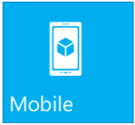



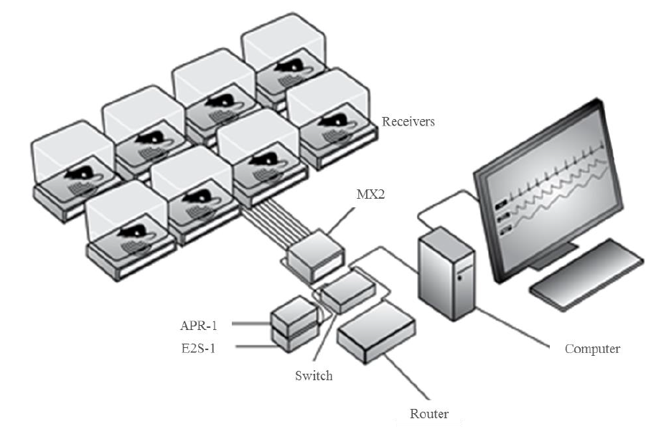
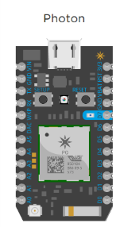

Project Use-Case
Remote subject monitoring of implantable telemetry devices
Visualizations for data trends
Notification on alarm events
Secure and Scalable
Technology
Particle Photon
Wi-Fi communications
2-way connectivity
Microsoft Azure IoT Tools
Data Visualization with Power BI
Web/Mobile configuration/notification
(free web-based service)

Slide 3
Project Steps
Program Photon
Turn on/off LED
OLED shield display for debugging
JSON webhook publish to particle cloud
Create Azure Event Hub
Define access policies and consumer groups
Azure Storage account
Azure Streaming Analytics to push to Power BI
Visualization of Live data/trends
View data on mobile App (Power BI)
HTML to change value (threshold/temp)
At certain threshold send email notification (IFTTT)

Slide 4


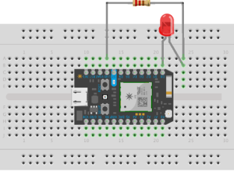
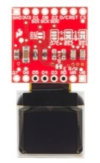

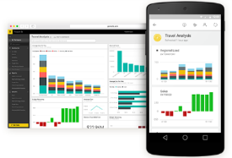



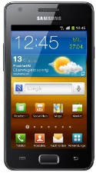


Project Steps (Visual)
Particle Photon
OLED Shield
74
100
Alarm Event
Particle.publish()
SQL Query
Select * into x from y
Outputs
Spark.function()
Access policies
Consumer groups
JSON WebHook

Slide 5
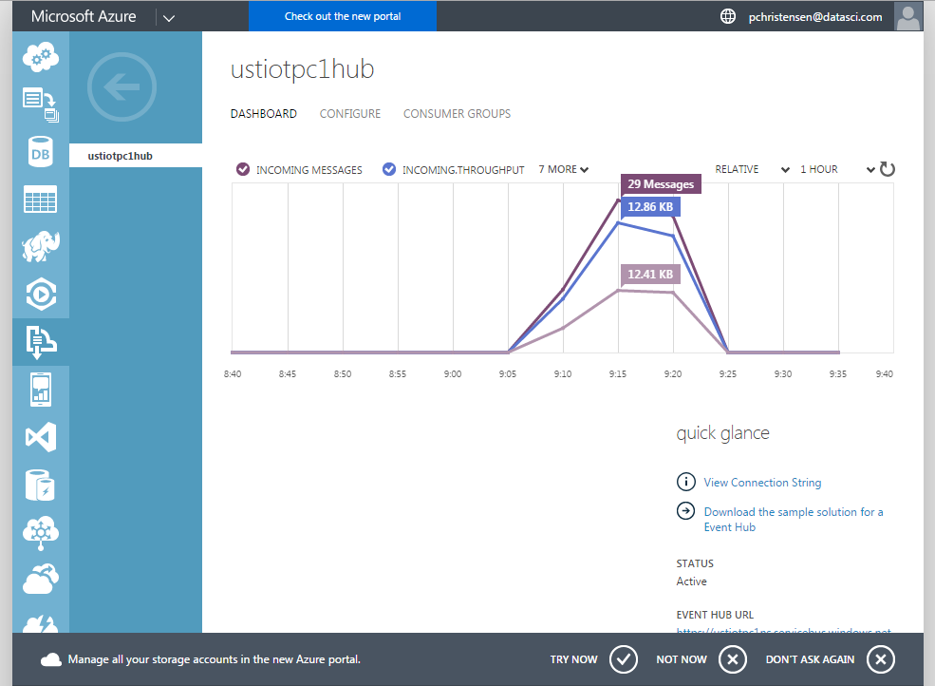
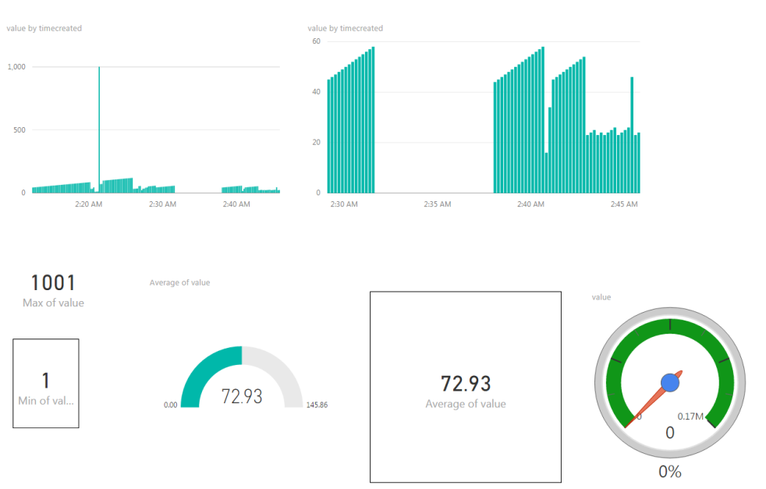
Demonstration
Particle Dashboard log files
LED ON/OFF
Alarm Event
Email notification
Visualization of Trend data
Azure
Event hub
Streaming Analytics
Power BI graphs
Power BI App

Slide 6
Next Steps
Real lab study data into Photon input
Configurable input data: BP, HRV, Temperature, ECG
Admin web site – control users, notifications, study meta data

Slide 7
Project Summary
Researchers notified of alarm events, can determine additional action
Don’t have to be in the lab
General enough for any data types -> any notification/visualization
Broad understanding of IoT technology and tools
Prototype to demonstrate remote notification and visualizations
Technologies
Particle Photon – event in/out
OLED shield
Webhook messages
Microsoft Azure
Event Hub
Streaming Analytics
Power BI
Mobile App (Power BI)
HTML
IFTTT
Recipes and Triggers
GitHub
DFU Utility (device FW upgrade)

Slide 8
Questions?

